Slide 1
UE17CS490A – Capstone Project Phase – 1
End Semester Assessment
Project Title : Smart Waste Segregation
Project ID : PW21CBR02
Project Guide : Prof. Charanraj B R
Project Team : Guruprasad Hadimani
Nagesh K J
Laxman M
Sanathkumar G

Slide 2
Agenda
Problem Statement
Abstract and Scope
Literature Survey
Suggestions from Review – 3
Design Approach
Design Constraints, Assumptions & Dependencies
Proposed Methodology / Approach
Architecture
Design Description
Technologies Used
Project Progress
References

Slide 3
Problem Statement
We aim to build a smart waste segregator that is capable of segregating the waste into different categories such as wet waste that contains moisture in it, metallic waste, glass waste, and plastic waste.
This is aimed to be achieved by using the intrinsic properties of different materials which they exhibit under different conditions.
These properties are as follows:
The ability of a metal to be attracted to a magnet or its property of induced eddy currents can be used for the identification of metal.
The property of dielectric constant is used to distinguish between glass and plastic.

Slide 4
Abstract and Scope
With the rapid growth in population, urbanization, and economic development the amount of waste that is being generated is increasing.
According to an estimate, the world generates 2.01 billion tonnes of solid waste annually. By 2050 the expected growth in the amount of waste generated will be increased to 3.04 billion.
The economic value of waste is realized only after its segregation. As the slogan states “Recycle today, for a better tomorrow”, the step involved in recycling waste is the proper segregation of waste.

Slide 5
Abstract and Scope
Most of the solid waste such as glass and plastics are recyclable, therefore we aim to segregate the wastes into the above-mentioned categories with the help of various sensors available and automate the process of segregation thereby reducing the manpower required for segregation which in turn reduces the occupational hazards of the manual workers.
Therefore, we aim to build a cost-effective and easy-to-use solution that can handle
the entire segregation process automatically.

Slide 6
Abstract and Scope
Benefits: Automating the process of waste segregation is helpful in many ways such as:
It reduces environmental pollution caused by the improper disposal ofmixed waste.
It reduces the amount of manpower required since the waste segregation happens automatically, which was traditionally done manually by laborers.
It reduces the hazards on the health of workers who manually segregate the waste by automating it.
Since the waste is segregated into different categories at the source, we can directly send the segregated waste into a recycling plant rather than first sending it to a segregation plant, which in turn reduces the overall time.

Slide 7
Literature Survey
Automatic Waste Segregation [1]
This paper proposes a system which helps in separating metal, dry, and wet waste automatically.
The system developed here consists of various small sub conveyor belts that protrude to a major conveyor belt.
The major conveyor belt is responsible for the segregation of waste. At the end of each conveyor, there is a dustbin that has IR sensors incorporated into it. This is done to detect any waste in the bins.
If found, the waste falls on the small sub conveyor belt. This is achieved by rotating the bin and then, the waste is moved to the major conveyor belt. At this point, the segregation begins.

Slide 8
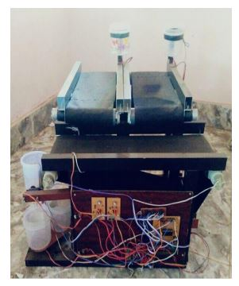
Literature Survey
A non-contact type metal sensor is used for the detection of metallic waste.
A capacitive proximity sensor is used to separate dry and wet waste.
IoT is also incorporated to count the number of wastes of different categories that are collected and then this information is available through a mobile app.
Working of the metallic waste detection module
The metallic waste detection module uses a non-contact type sensor which is used to detect the metallic objects that are close to it.
This uses the principle of eddy currents and a parallel resonance impedance system.
As the metallic object gets closer to the system, it reduces the amplitude for which a threshold is fixed, and then corresponding action is taken.

Slide 9
Working of the dry and wet waste detection module
A capacitive sensor is used for this purpose.
The dielectric constant of wet objects is greater than that of the dry objects. Therefore, if the change in capacitance value is more than a fixed threshold value, the waste is classified as wet else classified as dry.
Results and conclusions
Some materials that were detected as dry waste include paper, plastic, and dry cloth. Some materials that were classified as wet waste includes a banana peel, lemon, and wet cloth. Materials that were detected as metallic waste includes keys, and Aluminum sheet
Future scope
Waste can be categorized into biodegradable and non-biodegradable which is a useful classification.

Slide 10
Literature Survey
Automation of Plastic, Metal, and Glass Waste Materials Segregation using Arduino in Scrap Industry [2]
It aims to segregate the solid waste materials collected into three categories metals, glass, and plastic.
It also gives an insight into how waste is converted into energy using the syngas produced from waste.
This automated system will also reduce the hazards caused to manual waste segregator. It also tells that metal, glass, and plastic form the major part of waste materials.

Slide 11
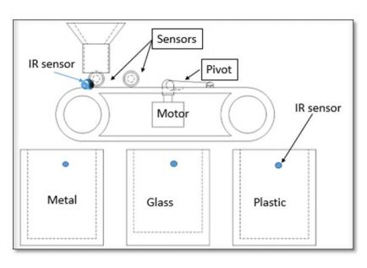
Working of the system
This system effectively uses three types of sensors:
IR sensor
Inductive sensor
Capacitive sensor
The functionality of each of these are:
First, the presence of an object(waste) on the conveyor is detected using an IR sensor later
when the inductive senor also gives a high output, the belt moves in the clockwise direction
to collect the metallic waste. If not, then the belt moves in the
anticlockwise direction until it reaches the capacitive sensor. After this, based on the output
generated by the capacitive sensor, the material is classified as glass or plastic.
If the output of the capacitive sensor is high, then the material is glass and if the output is
low, the material is plastic and hence, they are collected in their respective bins.

Slide 12
Conclusions and future work
Segregating dry and wet waste can be a possible extension.
The Capacitive sensors available only uses digital values therefore there is a need for a sensor that can read analog values which has many uses. This can reduce the overall cost of the system.
It also states that image processing can also be incorporated for segregation.
AN IoT Based Waste Segregator for Recycling Biodegradable and Non-Biodegradable Waste [3]
Usually, the waste is collected and dumped in a dump yard which is later either burnt or used as land to dump wastes exclusively. This will lead to the emission of harmful gases that affect the environment.
The paper aims to build an autonomous system which can separate waste into metallic, non-biodegradable, and biodegradable (dry and wet).

Slide 13
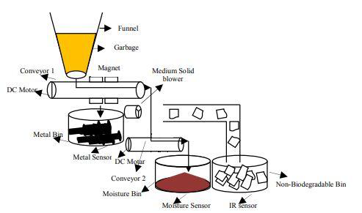
The system here is built using:
IR sensor
Moisture detection sensor
Medium speed blower
Magnet
Two conveyor belts
Working of the system
All the garbage is dumped into a funnel, then the waste is taken to the first conveyor belt. It consists of a magnet, which is used to separate metallic waste. All the metallic waste is first attracted by the magnet and it moves along with the conveyor. Later, there is a bin equipped with a metal detection sensor to detect the metallic waste.

Slide 14
The leftover garbage after extracting metallic waste is passed through a medium speed blower, using which lightweight materials such as papers, plastics are put into a separate bin.
Further, the leftover waste that is of higher weight than the plastics and papers fall over the second conveyor belt which leads to the moisture bin which has a moisture detection sensor below to sense all the wet waste coming into the bin.
IoT module is also integrated within the system to upload all the data from the sensors to a cloud which can be later used for processing and visualization.
Results
The metal waste accuracy is 95 percent. Paper waste was detected with an accuracy of 85 percent. The left out waste is dumped into the moisture bin, so the accuracy is 82 percent.

Slide 15
A unique technique for solid waste segregation [4]
This system consists of a conveyor belt mechanism that is used for segregation.
It also makes use of a blower for separating dry and wet waste.
Electromagnets are used for separating metallic waste. The working of this system is explained below.
Working of the system
The waste enters the blower section, the belt stops, and the blower is switched on thereby allowing the dry waste to be blown off to the dry bin.
Once the dry waste is segregated, the conveyor belt moves towards the metallic waste segregation section.
Once metallic wastes are removed from the electromagnet, it is de-magnetized. Hence, the metallic objects fall into the bin.
Then the belt starts to move again, to dump the remaining waste (wet waste) into the bin which is placed at the end of the belt.

Slide 16
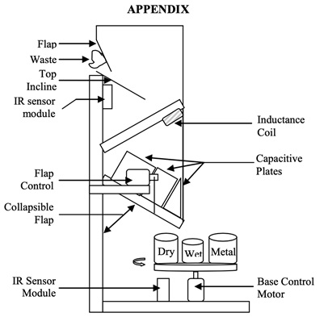
Conclusion
The waste is segregated into three different categories, namely metal, dry and wet waste, which means a division of waste into biodegradable and non-biodegradable
Automated Waste Segregation [5]
The idea in this paper is that waste segregation at the source is always better than doing it in the segregation plant.
The benefit of doing so is, it leaves us with higher quality materials from the waste for recycling. Also, the segregated materials are sent directly to the recycling plant for reuse.
The number of workers needed will also be reduced.

Slide 17
Working of the system
Once the waste enters the system, it slides over the inclined surface and falls on the inductance coil which is used to detect any metallic waste that is present in the waste.
It also uses the idea of parallel resonant impedance for segregation of metallic waste.
The waste moves down towards the second inclined surface.
If the garbage is non-metallic, then the capacitive sensing module starts sensing the object.
The property of the relative dielectric constant is used for the classification of waste.
Dry waste has a lower dielectric constant than wet waste since it has various fluids contained in it. If the output of the capacitive sensor is higher than a threshold, it is classified as wet waste else it is a dry waste.

Slide 18
Three bins are placed on a circular base, that can rotate and bring the correct container under the flap after the waste is identified.
Later the flap is lowered once the correct bin is under the flap so that the waste goes into the correct bin.
Limitations of the system
The system is capable of segregating one type of waste at once.
Some materials with a higher relative dielectric constant cannot be segregated into dry waste.
Conclusions and future work
This system has been implemented for segregating waste into metal waste, dry waste, and wet waste. Since it segregates only one type of waste at once, it can be improved to segregate mixed wastes by using buffer spaces.

Slide 19
Suggestions from Review - 3
Implement some functionality using sensors and integrate with the Arduino.
Make a video showcasing the implementation along with the explanations.
Send the report for plagiarism check.

Slide 20
Design Goals
The main design goal of our system is that we should efficiently segregate the waste into different categories such as wet, metallic, glass, and plastic. Some of the existing systems classify waste into dry, wet, and metallic. Some other system classifies them into glass and plastics. Since solid waste is one of the major categories of waste generated, our system integrates both the features so that a single system has multiple features and is more robust and useful.
Our system will segregate wastes that of not mixed, with higher accuracy and it may not very accurately classify the waste if they are mixed such as plastic dipped in water since we are first checking for the presence of water and later checking if it is plastic or not. The system is also designed in such a way to reduce the amount of power consumed by making the conveyor belt move only when there is some waste placed on the belt.
Design Approach

Slide 21
The alternate choices for metal detection were the usage of electromagnets for attracting metal pieces and some systems also used the concept of eddy currents for detection of metallic waste. We planned to use the inductive proximity sensors so that the design complexity of the system remains simple and also to reduce the overall cost of the system.
The other alternatives that were available for segregating wet and dry waste were the use of blowers. These systems used blowers to blow off the dry waste which is usually lighter when compared to wet waste. This system has the disadvantage of blowing away some of the wet waste also.
Therefore, we have designed our system using a moisture detection sensor, which is more accurate than blowers.
Design Approach

Slide 22
Pros :
• The system is simple and easy to use and also cost-effective.
• The entire system is automated where the user needs to place the waste material on the belt and the segregation is all automated.
• The system also uses less power by remaining in an ideal state unless the garbage is placed on it.
Cons:
• The system would not segregate waste accurately if it is mixed due to the limitations of the hardware used, which can sense only one property at a time.
• Any unforeseen hardware failures can prevent the entire system from working as intended
Design Approach

Slide 23
Design Constraints, Assumptions & Dependencies
Constraints: Garbage mixed and given for separation may not be classified into the correct category. For example, a plastic material dipped in water may not be classified as plastics due to the limitations of the hardware such as sensors used.
Assumptions: We need to place the garbage one by one for separation rather than dumping it all at once.
Dependencies: The dependency type of this system is Finish-to -Start that is the first task has to be completed before the second task can start. In our system, the separation of dry waste from wet waste needs to be completed first before further classification of dry waste into different categories. Likewise, the non-metallic waste needs to be segregated first from metallic waste before further classification of non-metals into plastic or glass.

Slide 24
Design Details
Novelty
This system tries to integrate many types of systems available, to make the system more usable and robust for use. This solution suggested is also a cost-effective solution.
Performance
The best performance of the system is when waste is placed individually on the belt for segregation. It can be measured as the number of materials classified per unit amount of time.
Maintainability
The system suggested here will require continuous examinations and regular maintenance since the hardwares used are prone to errors and failures.
Application compatibility
Since the Arduino used is compatible with almost all commercially available operating systems, it can be used with any of them which provides flexibility for use.

Slide 25
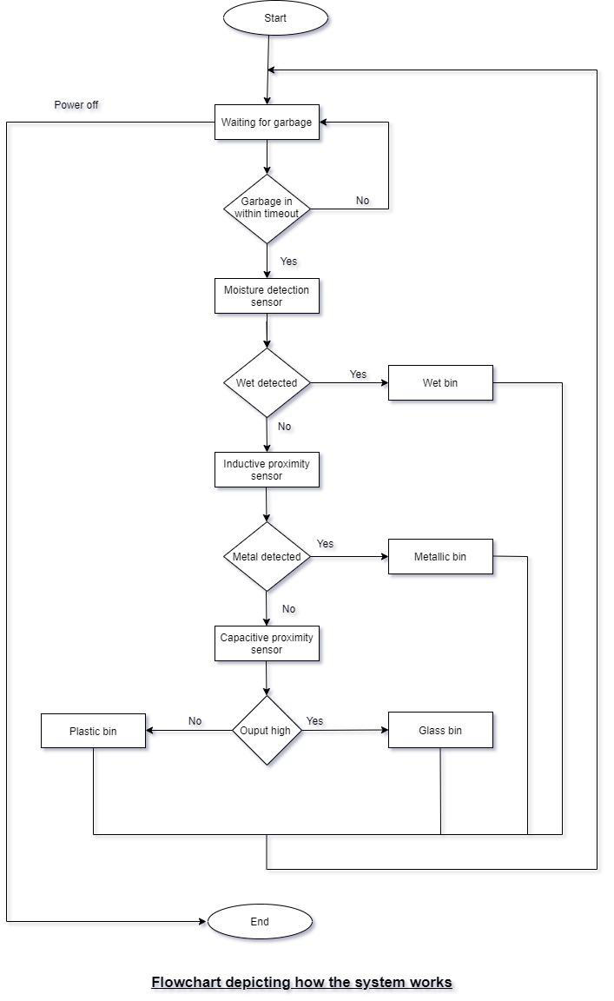
Proposed Methodology / Approach

Slide 26
Architecture
The modules of the system
conveyor belt module
moisture detection module
metal detection module
capacitive detection module
logic module which consists of the Arduino microcontroller.
The conveyor belt module is responsible for moving the waste placed on the belt to the detection sensor modules.
The moisture detection module gets the waste from the conveyor belt module and is responsible for detecting the wet waste using the moisture detection sensor.

Slide 27
Architecture
The metal detection module gets the waste from the conveyor belt module, and is responsible for detecting the metallic waste using the inductive proximity sensor.
The capacitive detection module gets the waste from the conveyor belt module, and is responsible for detecting the plastic/glass waste using the capacitive proximity sensor based on the value of the dielectric constant of the waste.
The logic module activates the respective servo motors for sweeping the waste into the bins depending on the output of all the other modules mentioned above.
All the above modules are interconnected using physical wires, connected to various pins of the Arduino board.

Slide 28
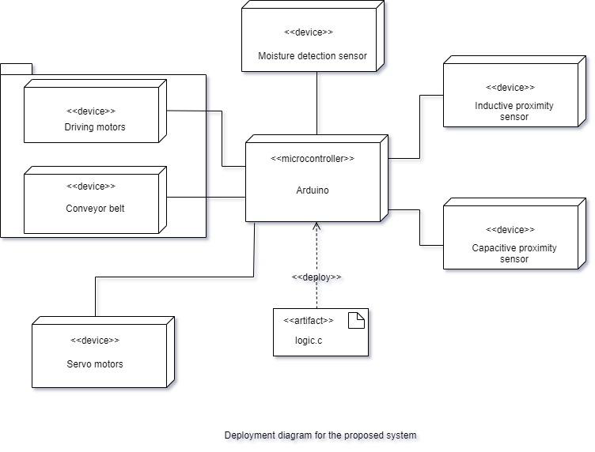
Architecture
Deployment Diagram

Slide 29
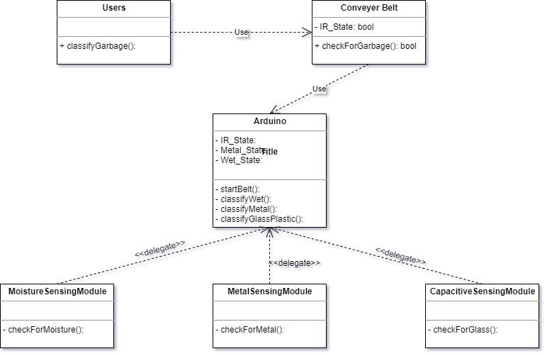
Design Description
Master Class Diagram

Slide 30
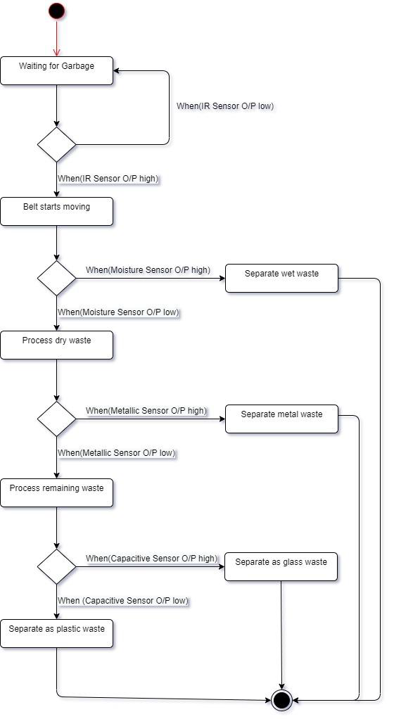
Design Description
State Diagram

Slide 31
Design Description
User Interface Diagrams
Our system does not contain any screen as such. It just has the conveyor belt on which the garbage is placed for segregation. This is the only interface with which the user will interact. The other part of the system with which the user interacts is the dustbins, which need to be emptied as and when the bins are full.
Report Layouts
The report for the verification and validation of the project contains the following:
1) Sl. No.
2) The material used for testing
3) Class of the material output by the system
4) Actual class of the material
Lastly, some metrics such as accuracy can be calculated based on the observations made during the testing.

Slide 32
Design Description
External Interfaces
Various devices are connected to the Arduino board using the various types of pins available such as:
1) Power pins: Used to supply power to the microcontroller.
2) Analog pins: Used to provide analog inputs to the microcontroller.
3) PWM pins: Used to provide PWM output can be used for dc motor driving.
4) Digital pins: Used to provide the inputs in the digital form to the microcontroller.
Other pins are also available for use.

Slide 33
Technologies Used
Arduino Integrated Development Environment:
This is an open-source software tool that facilitates the easy writing of the code which helps in faster development. This software tool also allows us to upload the written code into the Arduino board.
C programming language:
This is a general-purpose, procedural programming knowledge that can be used for various purposes. We use this to write code that controls the whole system

Slide 34
Project Progress
We have started the implementation of the project.
We have completed the implementation of ultrasonic sensor and moisture detection sensor and integrated both with the arduino using a breadboard.
25% of our project is complete and we will have to work on inductive proximity sensor, capacitive sensor and we should also build the conveyor belt.
The link to our video explanation of the implementation :
https://drive.google.com/drive/folders/1lFBP7b31BagYy2FH-UpDXNSc-GmhmQzp?usp=sharing

Slide 35
References
[1] N. S. Gupta, V. Deepthi, M. Kunnath, P. S. Rejeth, T. S. Badsha and B. C. Nikhil, "Automatic Waste Segregation," 2018 Second International Conference on Intelligent Computing and Control Systems (ICICCS), Madurai, India, 2018, pp. 1688-1692, doi: 10.1109/ICCONS.2018.8663148.
[2] M. Rafeeq, Ateequrahman, S. Alam and Mikdad, "Automation of plastic, metal and glass waste materials segregation using arduino in scrap industry," 2016 International Conference on Communication and Electronics Systems (ICCES), Coimbatore, 2016, pp. 1-5, doi: 10.1109/CESYS.2016.7889840.
[3] J. R. Raj, B. I. P. Rajula, R. Tamilbharathi and S. Srinivasulu, "AN IoT Based Waste Segreggator for Recycling Biodegradable and Non-Biodegradable Waste," 2020 6th International Conference on Advanced Computing and Communication Systems (ICACCS), Coimbatore, India, 2020, pp. 928-930, doi: 10.1109/ICACCS48705.2020.9074251.
[4] Mahesh Kumar AS | Rajesh A S "A Unique Technique forSolid Waste Segregation" Published inInternationalJournal of Trend inScientificResearchand Development(ijtsrd), ISSN: 2456-6470, Volume-3 |Issue-5, August2019, pp.604-607.

Slide 36
References
[5] A. Chandramohan, J. Mendonca, N. R. Shankar, N. U. Baheti, N. K. Krishnan and M. S.
Suma, "Automated Waste Segregator," 2014 Texas Instruments India Educators' Conference
(TIIEC),
Bangalore, 2014, pp. 1-6, doi: 10.1109/TIIEC.2014.009.
For component diagram:
https://www.visual-paradigm.com/guide/uml-unified-modeling-language/what-is-component-diagram/
For deployment diagram:
https://www.visual-paradigm.com/guide/uml-unified-modeling-language/what-is-deployment-diagram/
For state diagram:
https://www.guru99.com/state-machine-transition-diagram.html
https://www.smartdraw.com/state-diagram/

Slide 37
Thank You

